Slide 1
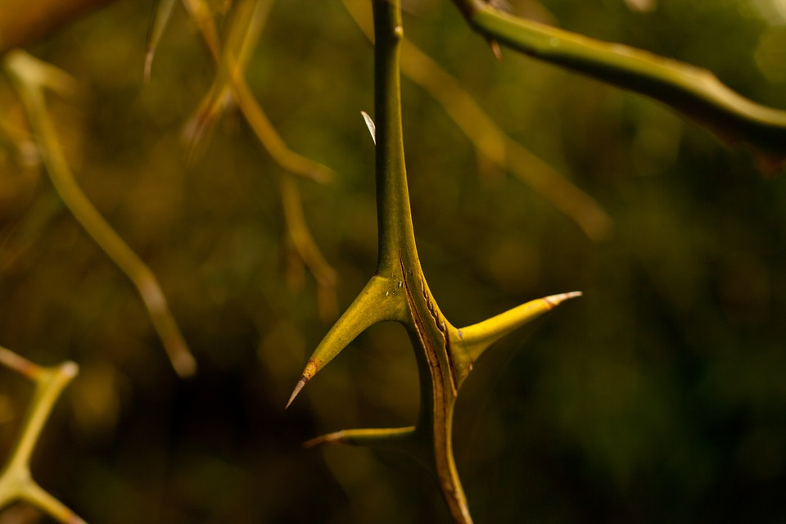
“The Nature of Sin”
a study of Genesis 3 for evangelism
part one:
Genesis
3:1-13

Slide 2
The Nature of Sin
(part one)
Genesis 3:1-5
“Now the serpent was more cunning than any beast...” [v1]
⬧ The serpent:
- A created being, creature (not eternal, though around since just after the beginning)
- Before sin, different from the creature we know as a snake now:
“...was more cunning than any beast of the field” [3:1]
it could talk! [3:1, 4-5]
The book of Revelation presents us with a “great dragon...that serpent of old, called the Devil and Satan, who deceives the whole world...” [Rv 12:9; 12:3]
it could walk (or fly?) [cp 3:14]
*Whether this serpent is an agent of the devil or Satan himself, for the purposes of our study we will treat it as being the devil
Chinese Dragon:
“that serpent of old”?
Genesis 3

Slide 3
The Nature of Sin
(part one)
Genesis 3:1-5
“Now the serpent was more cunning than any beast...” [v1]
⬧ The serpent:
- A created being, creature (not eternal, though around since just after the beginning)
- Before sin, different from the creature we know as a snake now
- Uses intelligence to postulate a very cunning question:
“Has God indeed said...?” [v1]
Genesis 3

Slide 4
The Nature of Sin
(part one)
“Has God indeed said?”
This tactic seeks to raise doubts about God's goodness:
God is, by Divine Nature, very good [cp Gn 1:4, 10, 12, 18, 21, 25, 31; Titus 1:2; James 1:17]
Even so, the world is tempted to believe that God is not good!
For Example: “Has God indeed said...”
- the world was created in only six days? [a “scientific”, unbelieving look at Genesis 1]
- woman's role is only “helper” and not “leader”? [distorting, despising Gn 2:18-25]
- marriage is only between one man and one woman? [despising of Gen 2:22-25]
- you cannot eat of every tree of the garden? [distorting, despising of Gen 2:16-17]
Genesis 3

Slide 5
The Nature of Sin
(part one)
Genesis 3:1-5
“Now the serpent was more cunning than any beast...” [v1]
⬧ The serpent:
- A created being, creature (not eternal, though around since just after the beginning)
- Before sin, different from the creature we know as a snake now
- Uses intelligence to postulate a very cunning question:
“Has God indeed said,
‘You shall not eat of every tree…?’”
vs
GOD
“Of every tree of the garden you may freely eat; But of the tree of the knowledge of good and evil you shall not eat...” [Gn 2:16-17]
SATAN
“You shall not eat of every tree of the garden...” [Gn 3:1]
...with one cunning question, God's freedom seems like prison!
Genesis 3

Slide 6
The Nature of Sin
(part one)
vs
GOD
SATAN
“Of every tree... you may freely eat...” [Gn 2:16]
“You shall not eat of every tree...” [Gn 3:1]
“All things are lawful for me, but not all things are helpful; all things are lawful for me, but not all things edify.” [1 Cor 10:23]
You cannot take advantage of all things: “Do not touch, do not taste, do not handle...” [Col 2:21-23; the “doctrines of men”, “appearance of wisdom”...]
“I have surely visited you and seen what is done to you in Egypt; and I have said I will bring you up out of the affliction of Egypt...” [Ex 3:16-17]
“We remember the fish we ate in Egypt that cost nothing...” [Nm 11:5 (ESV)]
“Marriage is honorable among all, and the bed undefiled; but fornicators and adulterers God will judge...” [Hb 13:4]
Marriage restricts your animal ‛needs’: “Foods for the stomach and the stomach for foods...” [1 Cor 6:13, context]
“And you shall know the truth, and the truth shall make you free...” [John 8:32]
Satan tempts us to believe that the truth is a lie that will restrict and imprison us: he asks falsely, “What is truth?” [John 18:38] “What is God really hiding from us...?”
Genesis 3

Slide 7
The Nature of Sin
(part one)
False RELIGION --
That is, when we uphold our traditions as though they were the law of God -- betrays a lack of faith in what God actually said!
[see Matthew 15:3-11]
Genesis 3:1-5
“Now the serpent was more cunning than any beast...” [v1]
⬧ The serpent:
- A created being, creature (not eternal, though around since just after the beginning)
- Before sin, different from the creature we know as a snake now
“Has God indeed said...?”
- Uses intelligence to postulate a very cunning question:
Eve responds: “We may eat the fruit of the trees of the garden; but of the fruit of the tree which is in the midst of the garden, God has said, ‛You shall not eat it, nor shall you touch it, lest you die.’ ”
- her answer to the serpent reveals at least two things:
she has thought a lot about God's command (and that tree!)
the question has begun to shake her trust in God and His word...
God said do not eat; she said do not even touch the tree!
- Eve was already seeing God's law as overly restrictive -- but the
restriction against touching the tree was her own invention!
Genesis 3

Slide 8
The Nature of Sin
(part one)
Genesis 3:1-5
“Now the serpent was more cunning than any beast...” [v1]
⬧ The serpent:
- A created being, creature (not eternal, though around since just after the beginning)
- Before sin, different from the creature we know as a snake now
“Has God indeed said...?”
- Uses intelligence to postulate a very cunning question:
- Seeing that Eve is shaken, the serpent goes a step further in his boldness, answering
her: "You will not surely die."
for the second time in four verses the serpent has boldly asserted exactly the opposite from what God had said
In order to “sell” his false doctrine, the serpent invents a “theology” about why what God said was not what God meant -- apparently, God has selfish, hidden motives for not letting them eat! “For God knows that in the day you eat of it your eyes will be opened, and you will be like God, knowing good and evil.” [Gn 3:5; a hidden blessing?]
in order to create false doctrine, all that is needed is one tiny word! (the same word used twice here: “not”)
Genesis 3

Slide 9
The Nature of Sin
(part one)
Genesis 3:6
“So when the woman saw that the tree was good...”
“For they being ignorant
of God's righteousness, and
seeking to establish their own righteousness, have not submitted to the righteousness of God.”
[Romans 10:3]
“...because, although
they knew God, they did
not glorify Him as God, ...but became futile in their thoughts, and their foolish hearts were darkened.” [Romans 1:21]
⬧ Once trust in God and in His word has been affected, human “reasoning”
takes over as a new guide for life...
Genesis 3

Slide 10
The Nature of Sin
(part one)
Genesis 3:6
“So when the woman saw that the tree was good...”
⬧ Once trust in God and in His word has been affected, human “reasoning”
takes over as a new guide for life...
- The woman begins to believe the serpent's theology because her own eyes “confirm”
what the serpent said; in this process the word of God, which has already given clear
teaching and instruction, is forgotten...
Genesis 3

Slide 11
The Nature of Sin
(part one)
Genesis 3:6
“So when the woman saw that the tree was good...”
⬧ Once trust in God and in His word has been affected, human “reasoning”
takes over as a new guide for life...
⬧ As the woman begins to give in to sin, she is attacked in three ways:
❶
The lust of the flesh: Eve “saw that the tree was good for food”. “Hunger” often describes every “appetite” of the physical body that desires to be fulfilled, whether for food or other passions. In this case, why would God deny the woman access to such good food?
❷
The lust of the eyes: Eve saw that “it was pleasant to the eyes”. She has more than she needs; but that forbidden fruit is so beautiful!
❸
The prideful lust for knowledge: she saw it was “desirable to make one wise”. A desire to know what God did not reveal, to be like Him. Is it possible God has hidden that which is really the best?
Genesis 3

Slide 12
The Nature of Sin
(part one)
Disarming Satan
Satan has a powerful, but limited arsenal...
With the woman [Gn 3:6]:
WE HAVE
EXPOSED SATAN!!
If we know what weapons
he will use, then we know how to shore up our defenses!! The word of God thoroughly equips us against Satan’s attacks!
[James 4:7; Eph 6:10-18;
1 Cor 10:13; etc]
With Jesus [Lk 4:1-13]:
- “the tree was good for food”
- “this stone...bread” [1-4]
- “pleasant to the eyes”
- “all will be yours” [5-8]
- “desirable to make one wise”
- “it is written: ...His angels
...to keep you” [9-12]
Analyze any sin:
it will fall into one of these 3 categories!
After thousands of years had passed, Satan still used the same old tactics...
“Now when the devil had ended every temptation...” [v13; Hb 4:15]
“...all that is in the world -- the lust of the flesh, the lust of the eyes, and the pride of life -- is not of the Father but is of the world. And the world is passing away, and the lust of it; but he who does the will of God abides forever.” 1 John 2:15-17
Genesis 3

Slide 13
The Nature of Sin
(part one)
Genesis 3:6
“So when the woman saw that the tree was good...”
⬧ Once trust in God and in His word has been affected, human “reasoning”
takes over as a new guide for life...
⬧ As the woman begins to give in to sin, she is attacked in three ways
⬧ Eve gave in to the full weight of temptation: “she took of its fruit and ate”
But WE don't have to give in!
- We have at least two things that Eve did not to help us in our fight:
the full counsel of God [see Rom 15:4; 1 Pet 2:2-4]
assured victory for those who are in Christ!
[see Col 2:6-15; Heb 2:14-18]
Genesis 3

Slide 14
The Nature of Sin
(part one)
Genesis 3:7-8
“Then the eyes of both of them were opened...” [v7]
⬧ The serpent was right! Their eyes were opened, just as he “promised”! [cp v5]
- In this is the deceitfulness of sin: because sin is of the world (as are our physical bodies),
it often seems truly to deliver the satisfaction that we are seeking!
• the adulterer imagines he will never be discovered [but cp Prov 7:21-23]
• the addict imagines he will use drugs only this one last time [but cp Prov 20:1; etc]
• the one who trusts in riches believes he is only being prudent [but cp Mt 6:19-21; etc]
Warning!
“For he who sows to his flesh will of the flesh reap corruption, but he who sows to the Spirit will of the Spirit reap everlasting life.” [Gal 6:8]
Genesis 3

Slide 15
The Nature of Sin
(part one)
Genesis 3:7-8
“Then the eyes of both of them were opened...” [v7]
⬧ The serpent was right! Their eyes were opened, just as he “promised”! [cp v5]
- In this is the deceitfulness of sin: because sin is of the world (as are our physical bodies),
it often seems truly to deliver the satisfaction that we are seeking!
- Consider the serpent's “promise” that their eyes would be opened. They are in paradise :
the Tree of the Knowledge of Good and Evil can only offer them knowledge of what?
• EVERYTHING they know and all they have been a part of up to now is GOOD only!
• this tree can only offer them knowledge of evil: but often that is the temptation!!
Genesis 3

Slide 16
The Nature of Sin
(part one)
Genesis 3:7-8
“Then the eyes of both of them were opened...” [v7]
⬧ The serpent was right! Their eyes were opened, just as he “promised”! [cp v5]
⬧ “…and they knew that they were naked” [v7]
- This new knowledge (of evil) did not bring a blessing, but brought shame
• once they had learned what they shouldn't have known, they could not simply return
to their state of prior innocence...
Genesis 3

Slide 17
The Nature of Sin
(part one)
Genesis 3:7-8
“Then the eyes of both of them were opened...” [v7]
⬧ The serpent was right! Their eyes were opened, just as he “promised”! [cp v5]
⬧ “…and they knew that they were naked” [v7]
- This new knowledge (of evil) did not bring a blessing, but brought shame
- “...and they sewed fig leaves together and made themselves coverings” [v7]
• now exposed, they tried to “cover” the shame of their new knowledge
• they make “coverings” ["aprons" (ASV); "loincloths" (ESV)]: “clothes” to hide and cover the
intimate parts of the body [cp Heb 4:13]
Genesis 3

Slide 18
The Nature of Sin
(part one)
Genesis 3:7-8
“Then the eyes of both of them were opened...” [v7]
“...they heard the sound of the LORD God...in the garden” [v8]
⬧ Later, we discover that the “sound” they heard was God’s voice [see 3:10]
- Like us, the relationship Adam and Eve had with God was based on His word!
- As with so many others, even in the Garden God presented Himself as Spirit
• cp how God presented Himself to Israel [Deut 4:36; 5:24; cp also Ex 33:12-18; 34:5-7 ]
• cp similarly Jesus as the “Word” of God who also is God [John 1:1-14; etc]
Genesis 3

Slide 19
The Nature of Sin
(part one)
Genesis 3:7-8
“Then the eyes of both of them were opened...” [v7]
“...they heard the sound of the LORD God...in the garden” [v8]
⬧ Later, we discover that the “sound” they heard was God’s voice [see 3:10]
⬧ “...Adam and his wife hid themselves from the presence of the LORD God”
Their new “knowledge” did not bring happiness; it only brought shame and
fear!!
- This is one of the saddest moments in human history: God sought fellowship with
the man He had made and man hid himself from God's presence!
• can you imagine a more beautiful moment than hearing the voice of God calling to
you as He comes to visit you in the perfect garden paradise? Yet
it was at this sound that they sought to hide themselves!
What had GOD ever done that they should fear Him??
Why would they hide from GOD?
Genesis 3

Slide 20
The Nature of Sin
(part one)
Genesis 3:7-8
“Then the eyes of both of them were opened...” [v7]
“...they heard the sound of the LORD God...in the garden” [v8]
⬧ Later, we discover that the “sound” they heard was God’s voice [see 3:10]
⬧ “...Adam and his wife hid themselves from the presence of the LORD God”
- This is one of the saddest moments in human history: God sought fellowship with
the man He had made and man hid himself from God's presence!
- Note that they hid themselves from God and not vice-versa; even with their sin,
God sought for them...
• they hid “among the trees of the Garden”; they had already made
“coverings” for themselves from leaves, but when they perceived
that they were still naked, they tried to use the whole tree!
Genesis 3

Slide 21
The Nature of Sin
(part one)
Genesis 3:9-11
“Then the LORD God called to Adam...‘Where are you?’” [v9]
⬧ Seeing that the man has hidden himself, God continues seeking fellowship
- In asking, “Where are you?”, is it possible that God does not know where Adam is?
• Of course God knows where Adam is. He wants the man to come back to Him, and
in order for that to happen, there must first be a confession of wrongdoing.
[cp Mark 1:4, 15; Luke 24:46-47; etc]
Genesis 3

Slide 22
The Nature of Sin
(part one)
Genesis 3:9-11
“Then the LORD God called to Adam...‘Where are you?’” [v9]
⬧ Seeing that the man has hidden himself, God continues seeking fellowship
⬧ “...he said, ‛I heard Your voice in the garden, and I was afraid because I was
naked; and I hid myself...” [v10]
- Is it possible to be "dressed" (“coverings” of leaves) and yet still naked? The man
admits that the “clothes” he made were insufficient to cover him...
We must develop the mind of God if we are to deal properly with the problems that the world presents us with. Genesis 3 will show later that these “clothes” were quite insufficient, and God will properly clothe them. In a world where sin is turned loose, we must dedicate ourselves to seek God’s perspective for a life that will please God in all areas and in every way...
Genesis 3

Slide 23
The Nature of Sin
(part one)
Genesis 3:9-11
“Then the LORD God called to Adam...‘Where are you?’” [v9]
⬧ Seeing that the man has hidden himself, God continues seeking fellowship
⬧ “...he said, ‛I heard Your voice in the garden, and I was afraid because I was
naked; and I hid myself...” [v10]
⬧ “...Have you eaten from the tree of which I commanded you...?” [v11]
- Of course, God clearly knows the answer to this question as well. So why ask?
Confessing sin is a humbling act which puts us back on the path to fellowship with God. If we do not admit our sin, there is no way we can repent and therefore no way that we can be forgiven...
Confession, just like prayer, is not for God – He already knows what we have done (and what we need) before we ask [cp Mt 6:8]. Confession and prayer are for OUR own good!
Genesis 3

Slide 24
The Nature of Sin
(part one)
Genesis 3:12-13
No! He only shifted the blame to someone else!
“Then the man said, ‛The woman whom You gave to be with me,
she gave me of the tree, and I ate.” [v12]
⬧ Did Adam really confess his sin?
I'm sorry”; “I did wrong”; “I sinned” – that's the way a humble confession begins. In a false 'confession', which is really just a transfer of blame to another person or to some circumstance (a justification), the last words are: “…well, so then, because of all these other things, I had to do it…”
Adam placed the “I did wrong” at the end of his confession, justifying himself instead of accepting that he had truly done wrong
Genesis 3

Slide 25
The Nature of Sin
(part one)
Genesis 3:12-13
“Then the man said, ‛The woman whom You gave to be with me,
she gave me of the tree, and I ate.” [v12]
⬧ Did Adam really confess his sin?
⬧ Whom did Adam blame for his sin?
- Did you catch that?! He blamed GOD! “It was YOU who gave this woman to be with me!”
Genesis 3

Slide 26
The Nature of Sin
(part one)
Genesis 3:12-13
“Then the man said, ‛The woman whom You gave to be with me,
she gave me of the tree, and I ate.” [v12]
“The woman said, ‛The serpent deceived me, and I ate.” [v13]
⬧ Did Eve confess her sin?
- Eve, like Adam before her, placed the “I ate” as a justification and not a confession
Genesis 3

Slide 27
The Nature of Sin
(part one)
Genesis 3:12-13
“Then the man said, ‛The woman whom You gave to be with me,
she gave me of the tree, and I ate.” [v12]
“The woman said, ‛The serpent deceived me, and I ate.” [v13]
WHICH YOU
CREATED!
⬧ Did Eve confess her sin?
⬧ Whom did Eve blame for her sin?
- was she more “noble” than Adam in passing the blame to the serpent?
Did you catch that?! She also blamed GOD!
Genesis 3

Slide 28
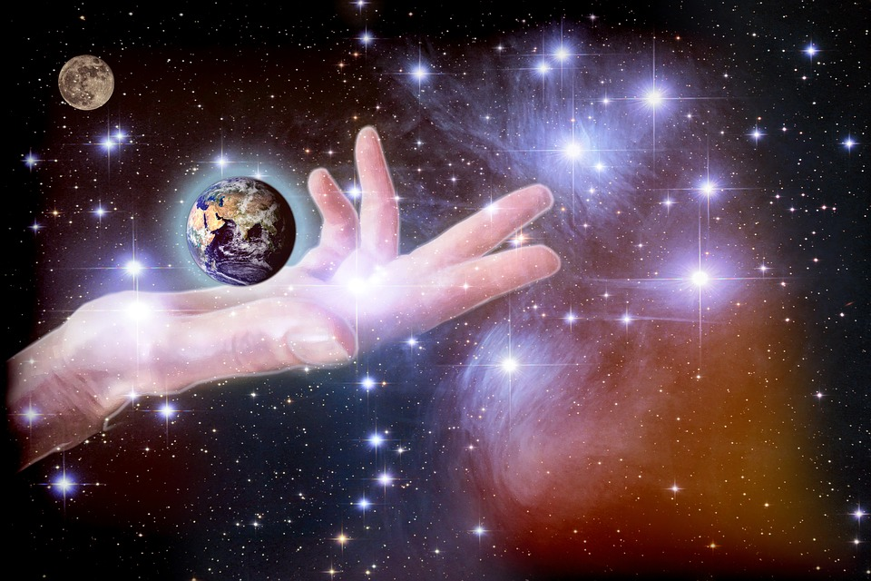
The Nature of Sin
(part one)
Order by decree
The disorder of sin
God the Creator;
Sovereign over
whole universe
The “serpent”; gives a new order/word
to the woman
Sin
completely inverts the order God decreed at creation:
Man; given
“dominion”
over all the
animals
Woman; instead of ‘help’ she gives the man forbidden fruit
Woman; his
“comparable
helper”
Man;
knowing God’s
orders, decides
to disobey Him
The “serpent”; a
creature made to
serve man
God the Creator;
is despised and
blamed by all

Slide 29
The Nature of Sin
(part one)
Order by decree
The disorder of sin
The correction that comes from God aims
to restore the spiritual order that He decreed from the beginning, in place of the “natural” order resulting from disobedience...
The “serpent”; gives a new order/word
to the woman
God the Creator;
Sovereign over
whole universe
Sin
completely inverts the order God decreed at creation:
Man; given
“dominion”
over all the
animals
Woman; instead of ‘help’ she gives the man forbidden fruit
Where are YOU?
Have you hidden yourself?
Do you feel exposed, afraid?
He is seeking for you;
would you come to Him?
Woman; his
“comparable
helper”
Man;
knowing God’s
orders, decides
to disobey Him
The “serpent”; a
creature made to
serve man
God the Creator;
is despised and
blamed by all

